Slide 1
Data Development Utilizing Database Design and SQL
Day 3
Notes:
1

Slide 2
Introduction
Structured Query Language (SQL)
Most popular and widely used language for retrieving and manipulating database data
Developed in mid 1970s
Used by most DBMSs

Slide 3
Creating and Running SQL Commands
Oracle Database 11g Express
Software used in class to illustrate SQL
Commands will work the same in other versions of Oracle
Differences between Oracle and other databases are noted in special boxes
MySQL database will be introduced in a later module.

Slide 4
Using the Oracle Database 11g Express Edition
App loads in your web browser
Must have a DBA database role username and password
Create a workspace
A work area that allows multiple users to work with the same installation of Oracle
Login to the workspace

Slide 5
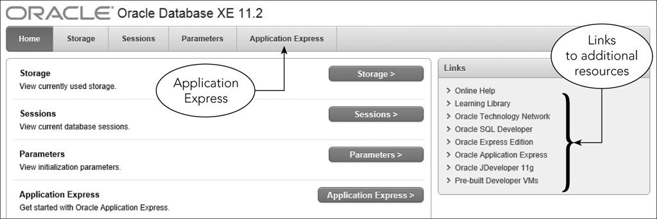
Using the Oracle Database 11g Express Edition
Figure 3-1: Oracle Database 11g Express Edition home page

Slide 6
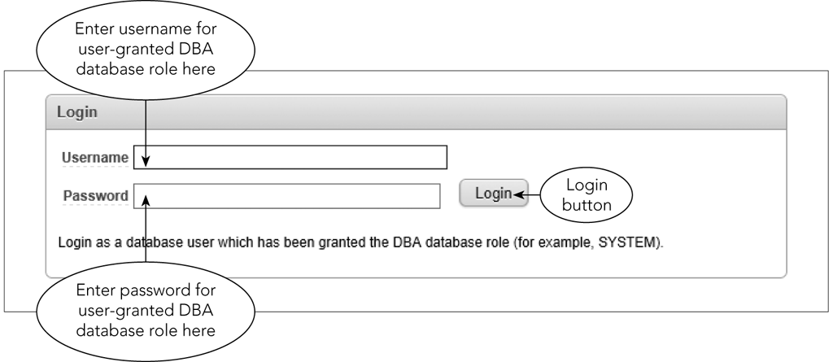
Using the Oracle Database 11g Express Edition
Figure 3-2: Entering the username and password for a DBA user

Slide 7
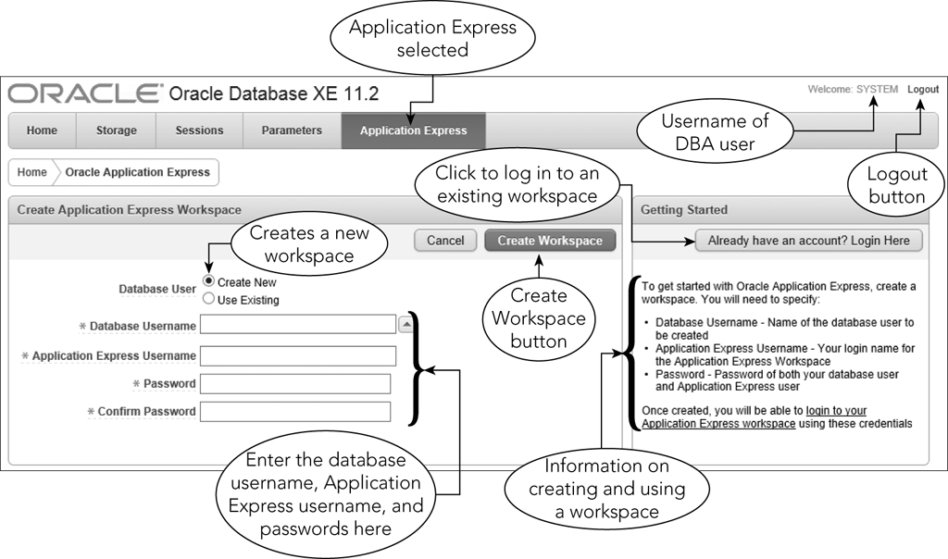
Using the Oracle Database 11g Express Edition
Figure 3-3: Creating a new workspace

Slide 8
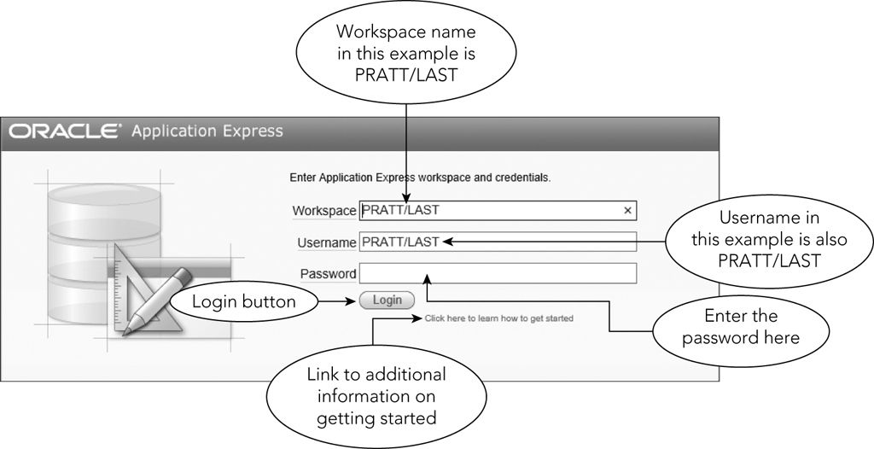
Using the Oracle Database 11g Express Edition
Figure 3-4: Logging in to an Application Express workspace

Slide 9
Using the Oracle Database 11g Express Edition
Application Express home page provides access to various tools
Use SQL Workshop tool in this text
SQL Scripts page displays scripts

Slide 10
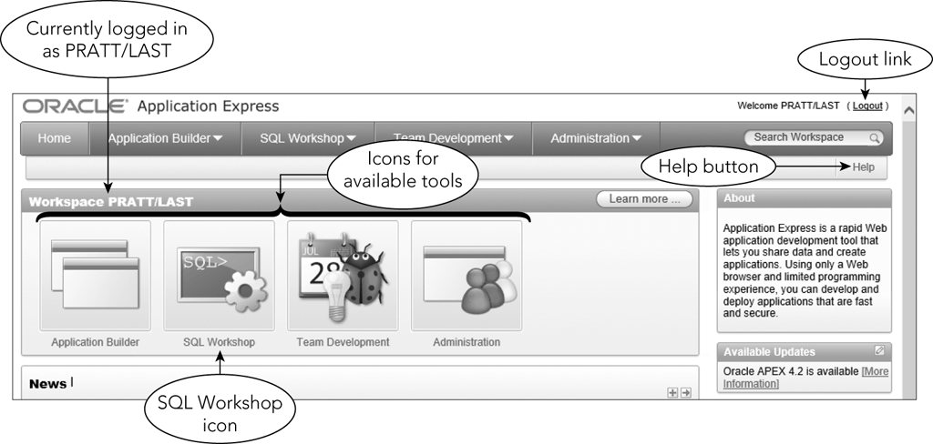
Using the Oracle Database 11g Express Edition
Figure 3-5: Oracle Application Express home page

Slide 11
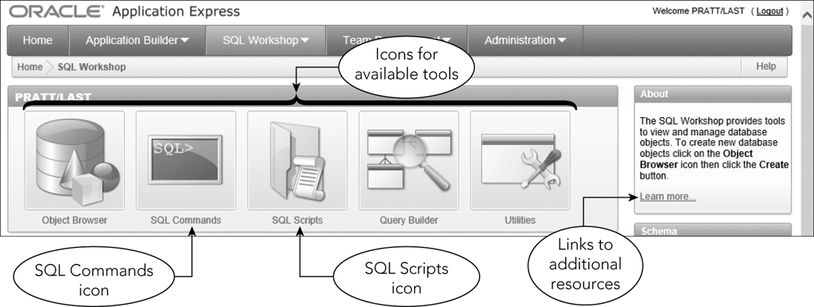
Using the Oracle Database 11g Express Edition
Figure 3-6: SQL Workshop page

Slide 12
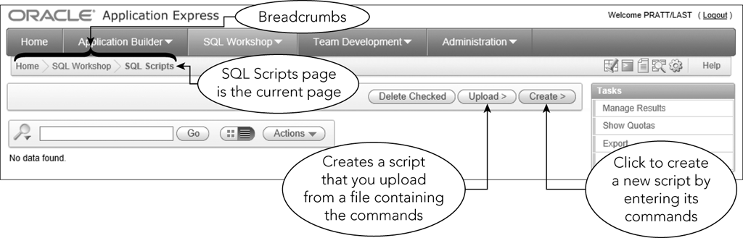
Using the Oracle Database 11g Express Edition
Figure 3-7: SQL Scripts page

Slide 13
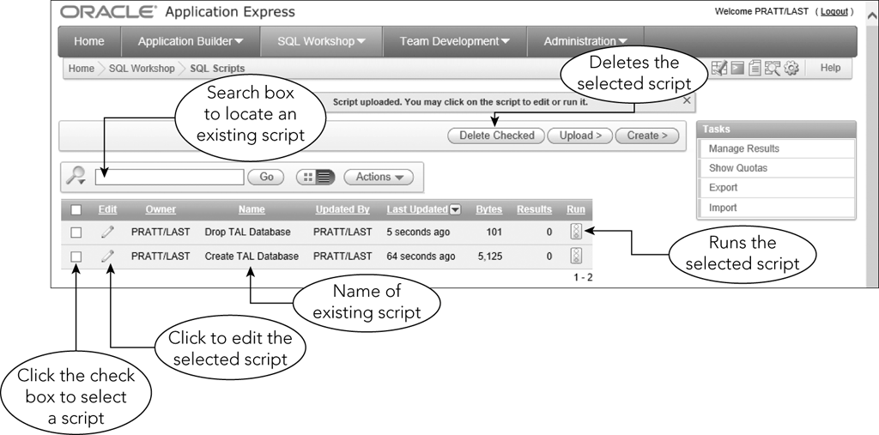
Using the Oracle Database 11g Express Edition
Figure 3-8: Two scripts displayed on the SQL Scripts page

Slide 14
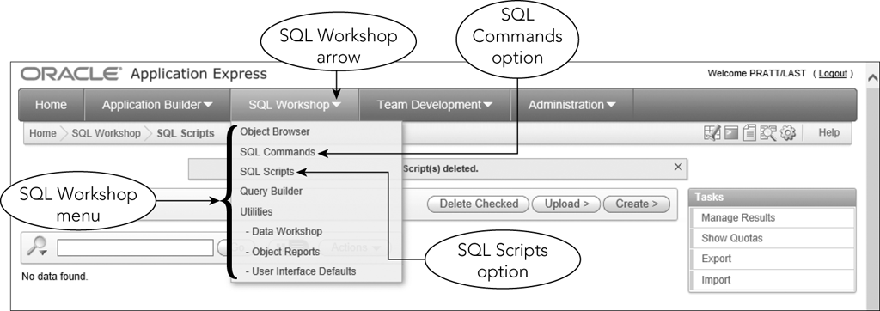
Entering Commands
Figure 3-9: SQL Workshop menu

Slide 15
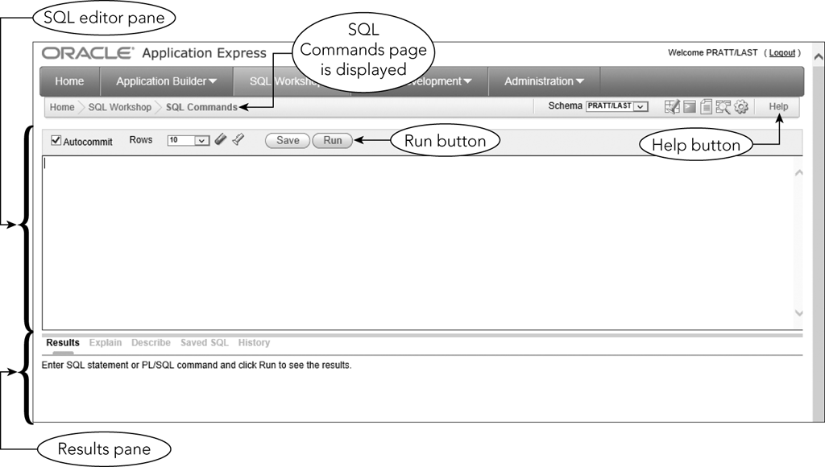
Entering Commands (continued)
Figure 3-10: SQL Commands page

Slide 16
Creating a Table
Describe the layout of each table in the database
Use CREATE TABLE command
TABLE is followed by the table name
Follow this with the names and data types of the columns in the table
Data types define type and size of data

Slide 17
Creating a Table
Table and column name restrictions
Names cannot exceed 30 characters
Must start with a letter
Can contain letters, numbers, and underscores (_)
Cannot contain spaces

Slide 18
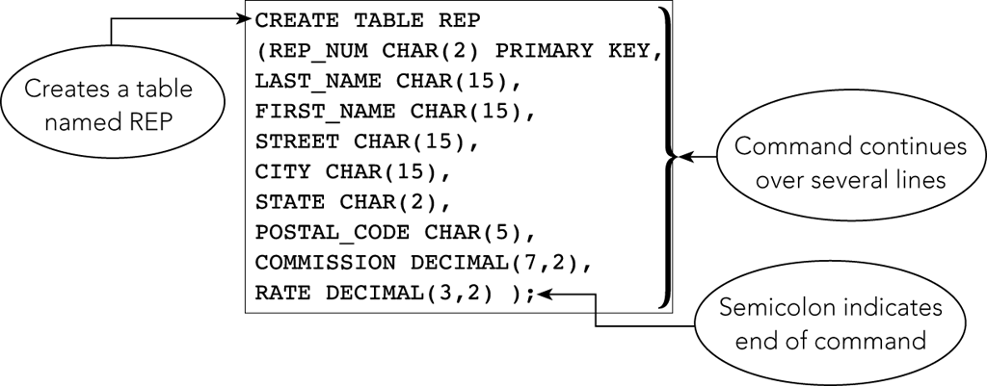
Creating a Table
Figure 3-11: CREATE TABLE command for the REP table

Slide 19
Creating a Table
Commands are free-format; no rules stating specific words in specific positions
Indicate the end of a command by typing a semicolon
Commands are not case sensitive
In Oracle, enter the command in the SQL editor pane

Slide 20
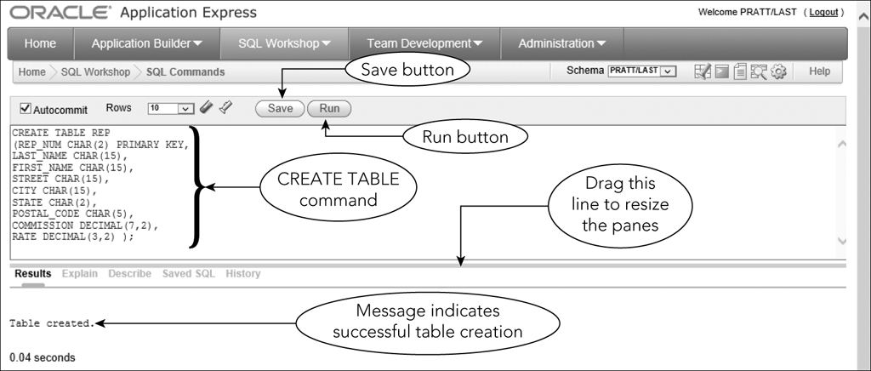
Creating a Table in Oracle
Figure 3-12: Running the CREATE TABLE command for the REP table

Slide 21
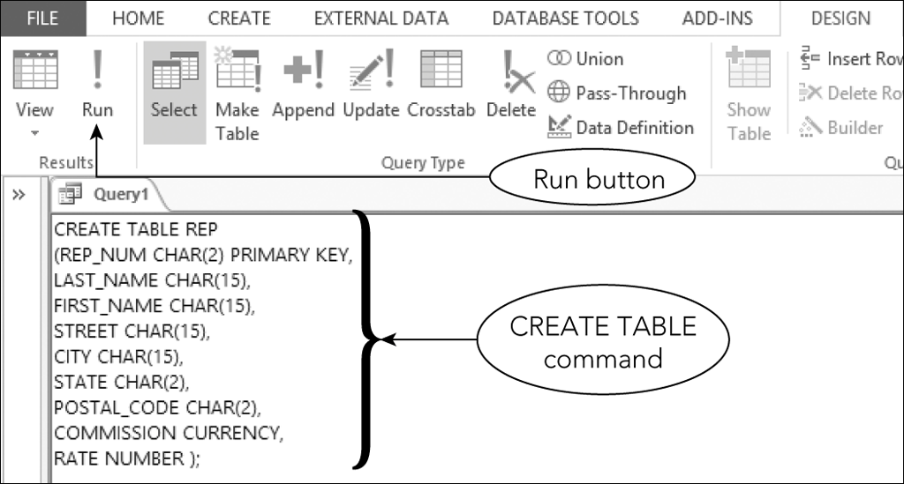
Creating a Table in MS Access
Figure 3-13: Using Access SQL view to create a table

Slide 22
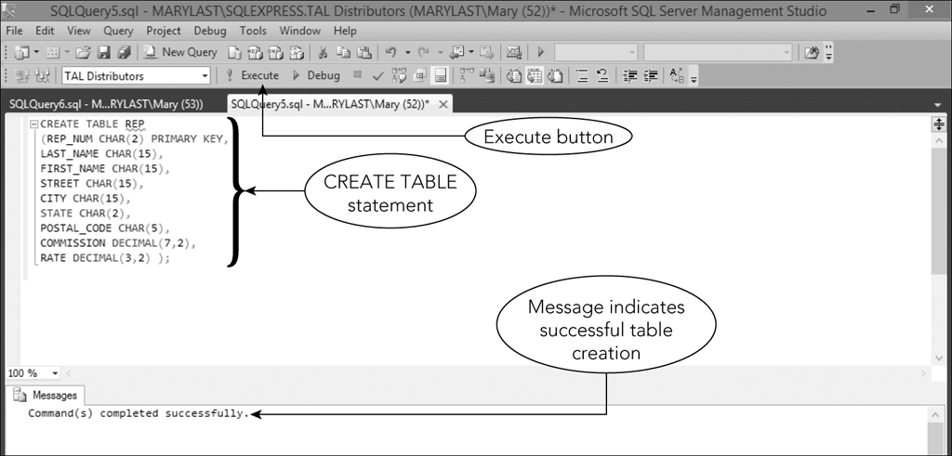
Creating a Table in MS SQL Server
Figure 3-14: Using Microsoft SQL Server to create a table

Slide 23
Correcting Errors in SQL Commands
Use the same techniques that you might use in a word processor
Make changes and click Run button to execute command again
Check Results pane to determine if command executed successfully

Slide 24
Dropping a Table
Can correct errors by dropping (deleting) a table and starting over
Useful when table is created before errors are discovered
Command is followed by the table to be dropped and a semicolon
Any data in table also deleted

Slide 25
Exercise
If Oracle is not installed on your workstation, download, install and configure Oracle Express Edition Database:
Download: http://www.oracle.com/technetwork/database/database-technologies/express-edition/downloads/index.html
Install: http://docs.oracle.com/cd/E17781_01/install.112/e18803/toc.htm#XEINW133
Getting Started: http://docs.oracle.com/cd/E17781_01/admin.112/e18585/toc.htm#XEGSG109
Create a table REP as described in slides 16-20.

Slide 26
Using Data Types
For each column, the type of data must be defined
Common data types
CHAR(n)
VARCHAR(n)
DATE
DECIMAL(p,q)
INT
SMALLINT

Slide 27
Using Nulls
A special value to represent a situation when the actual value is not known for a column
Can specify whether to allow nulls in the individual columns
Should not allow nulls for primary key columns

Slide 28
Using Nulls
Use NOT NULL clause in CREATE TABLE command to exclude the use of nulls in a column
Default is to allow null values
If a column is defined as NOT NULL, system will reject any attempt to store a null value there

Slide 29
Using Nulls
CREATE TABLE REP
(REP_NUM CHAR(2) PRIMARY KEY,
LAST_NAME CHAR(15) NOT NULL,
FIRST_NAME CHAR(15) NOT NULL,
STREET CHAR(15),
CITY CHAR(15),
STATE CHAR(2),
POSTAL_CODE CHAR(5),
COMMISSION DECIMAL(7,2),
RATE DECIMAL(3,2) );

Slide 30
Adding Rows to a Table
INSERT Command
INSERT INTO followed by table name
VALUES command followed by specific values in parentheses
Values for character columns in single quotation marks

Slide 31
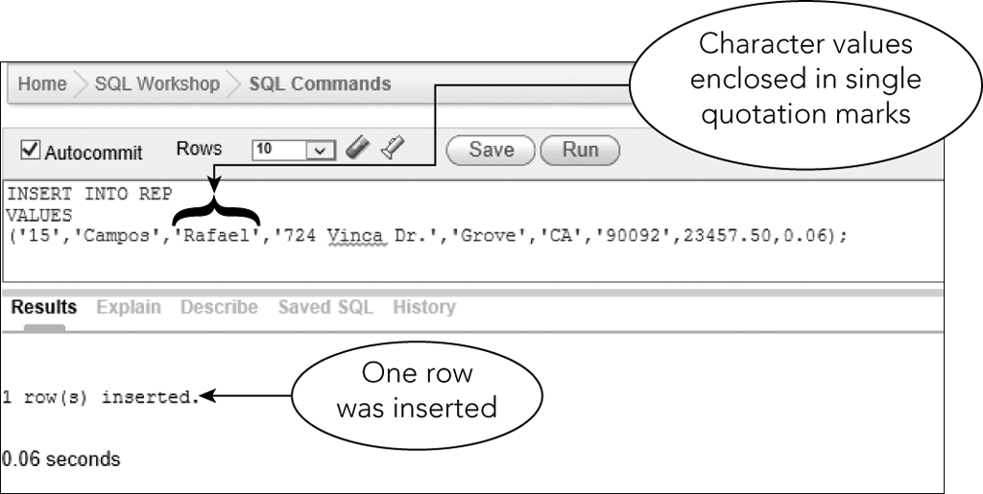
The Insert Command
Figure 3-17: INSERT command for the first record in the REP table

Slide 32
The INSERT Command
To add new rows, modify previous insert command
Use same editing techniques as those used to correct errors

Slide 33
Inserting a Row that Contains Nulls
Use a special format of INSERT command to enter a null value in a table
Identify the names of the columns that accept non-null values and then list only the non-null values after the VALUES command

Slide 34
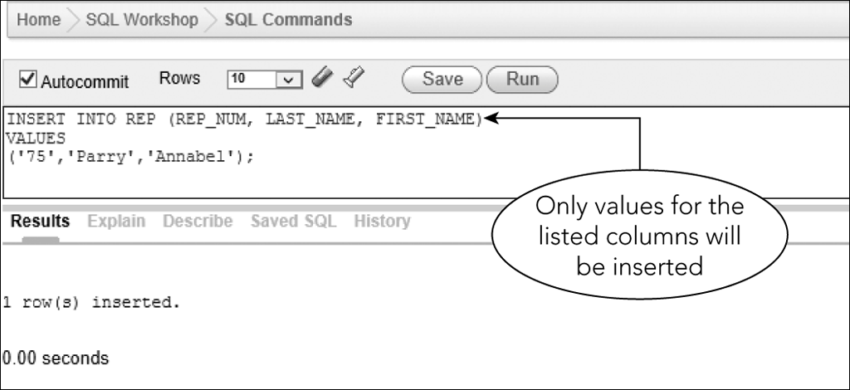
Inserting a Row that Contains Nulls
Figure 3-20: Inserting a row that contains null values in the REP table

Slide 35
Exercise
Following instructions on slides 31-34, insert several records into the REP table you created in the previous exercise.

Slide 36
Viewing Table Data
Use SELECT command
Can display all the rows and columns in a table
SELECT * FROM followed by the name of the table
Ends with a semicolon

Slide 37
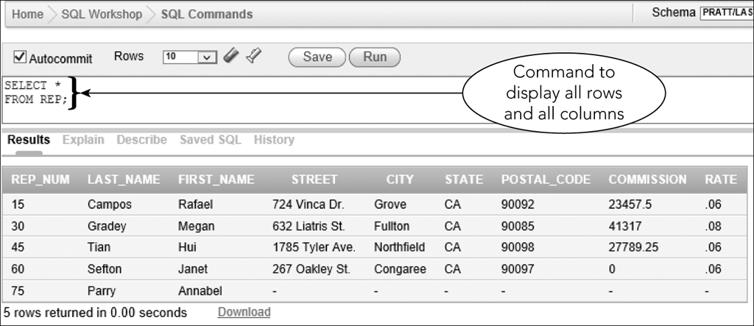
Viewing Table Data
Figure 3-21: Using a SELECT command to view table data

Slide 38
Viewing Table Data
In MS Access
Enter SELECT statement in SQL view
In MS SQL Server
Enter SELECT statement in Query Editor window

Slide 39
Correcting Errors in a Table
UPDATE command is used to update a value in a table
DELETE command allows you to delete a record
INSERT command allows you to add a record

Slide 40
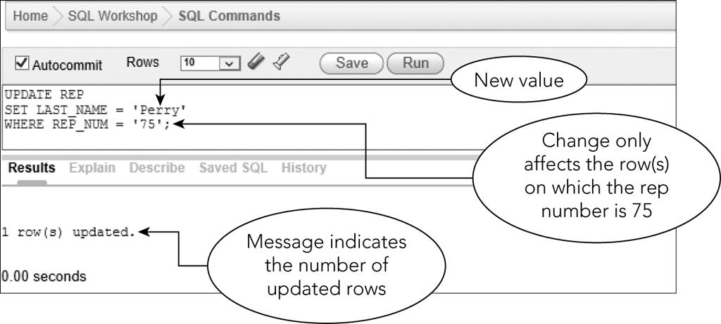
Correcting Errors in a Table
Figure 3-26: Using an UPDATE command to change a value

Slide 41
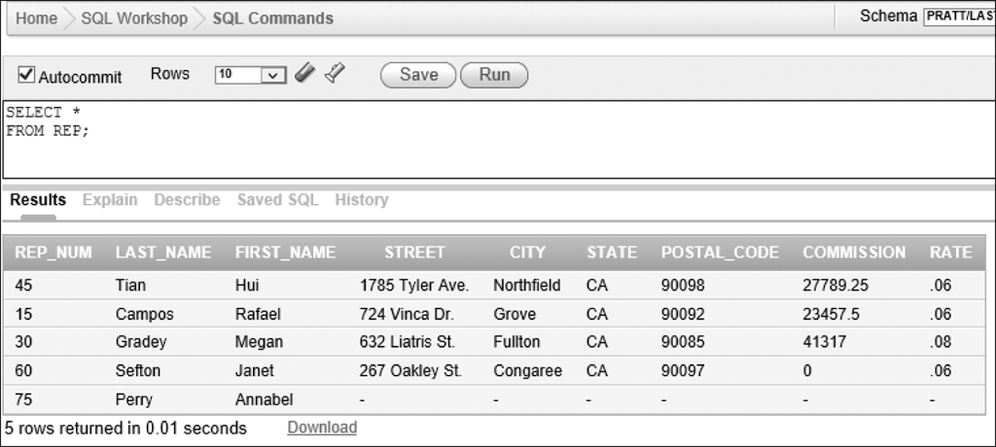
Correcting Errors in a Table
Figure 3-27: Last name changed for sales rep number 75

Slide 42
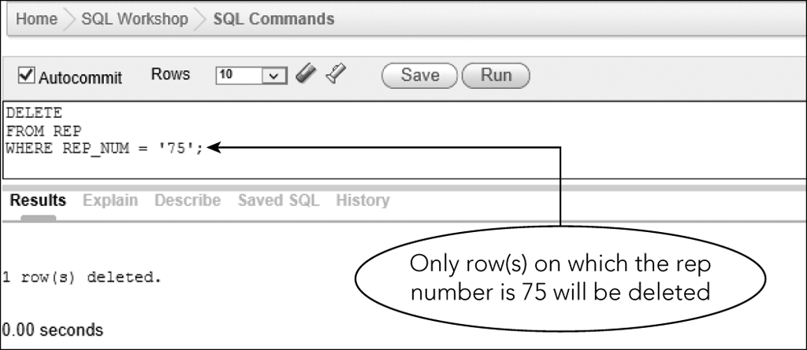
Correcting Errors in a Table
Figure 3-28: Using a DELETE command to delete a row

Slide 43
Exercise
Use the SELECT SQL statement to view the contents of your REP table.
Use the UPDATE SQL statement to update one REP record.
Use the DELETE SQL statement to delete another REP record.
Use the SELECT SQL statement to view the contents of your REP table after the changes.

Slide 44
Saving SQL Commands
Allows you to use commands again without retyping
Save commands in a script file or script
Text file with .sql extension
Script repository
Special location in Oracle
Can download to local drive

Slide 45
Saving SQL Commands
To create a script file in Oracle:
Use Script Editor page
Enter a name for script
Type the command or commands to save in script
Save the script

Slide 46
Saving SQL Commands
Once a script file is created:
Can view, edit, or run
Can delete
Can download from script repository to local drive
Can upload from local drive to script repository

Slide 47
Describing a Table
DESCRIBE command (Oracle)
Documenter tool (Access)
Exec sp_columns command (SQL Server)

Slide 48
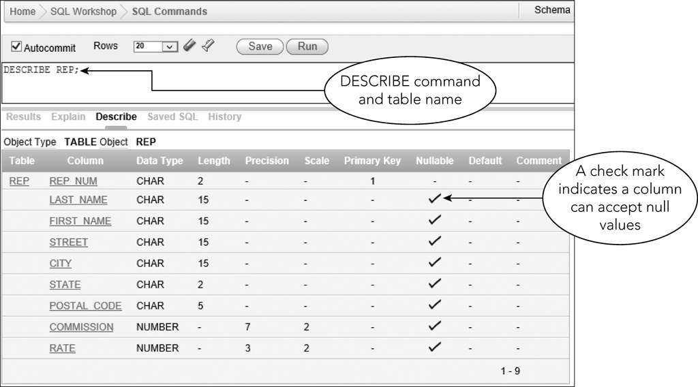
Describing a Table
Figure 3-38: DESCRIBE command for the REP table

Slide 49
Summary
Use the CREATE TABLE command to create tables
Use the DROP TABLE command to delete a table
CHAR, VARCHAR, DATE, DECIMAL, INT, and SMALLINT data types
Access does not support DECIMAL

Slide 50
Summary
Null value used when actual value for a column is unknown, unavailable, or not applicable
Use NOT Null clause to identify columns that cannot have a null value
Use INSERT command to add rows
Use SELECT command to view data in a table

Slide 51
Summary
Use UPDATE command to change the value in a column
Use DELETE command to delete a row
Save SQL commands in a script file
Use DESCRIBE command to display a table’s structure

Slide 52
Exercise
Figures 3-30 through 3-37 in the book give additional table information for TAL Distributors
Execute appropriate CREATE TABLE and INSERT commands to create the remaining tables with sample data.
Save these commands as scripts
You may want to put a “delete table” statement before each “create table” statement.
Don’t forget to separate multiple commands in a script file with a semicolon.

